Slide 1

CBD
THC
CBD:THC
INSUFFICIENT
Cannabinoid Therapeutics Clinical Evidence Reference
Non-promotional evidence matrix for UK prescribers mapping 18 indications across 5 evidence levels
VERSION 1.0
WORKING DRAFT
27 REFERENCES
References and regulatory positions require independent verification before external clinical, regulatory, or promotional use. This document does not constitute medical advice.
Cannabinoid Therapeutics Clinical Evidence Reference | Non-promotional | For prescriber reference only

Slide 2

01 / PURPOSE
01
This reference maps clinical evidence strength, not prescribing recommendations
Evidence mapping
Covers 18 clinical indications across 5 evidence levels, from licensed/strongest (Level 1) to preclinical (Level 5)
02
Summarises the relative evidence base for CBD, THC, and CBD:THC products across 18 indications. Identifies which molecule has the prevailing evidence and the strength of that evidence for each indication.
Molecule identification
For each indication, identifies whether CBD, THC, or a combination has the prevailing evidence base
03
Not a prescribing recommendation
Does not replace patient-specific clinical judgement, product-specific regulatory review, or local governance
04
UK prescriber focus
Intended for clinicians working within licensed-medicine and Specials pathways in UK practice
Cannabinoid Therapeutics Clinical Evidence Reference | Non-promotional
2 / 15

Slide 3

02 / EVIDENCE GRADING
Five-level evidence grading from licensed/strongest to preclinical
Each indication is assigned a single evidence level based on the strongest available clinical data
1
2
3
4
5
LICENSED / STRONGEST
STRONG RCT
MODERATE
EMERGING
PRECLINICAL
Multiple Phase 3 RCTs and/or regulatory approval in the indication
Single adequately powered Phase 3 RCT
Phase 2 RCT(s) or meta-analysis of moderate-quality trials
Open-label, observational cohort, or single small RCT
Preclinical or mechanistic data only
1 indication
1 indication
6 indications
6 indications
4 indications
Cannabinoid Therapeutics Clinical Evidence Reference | Non-promotional
3 / 15

Slide 4
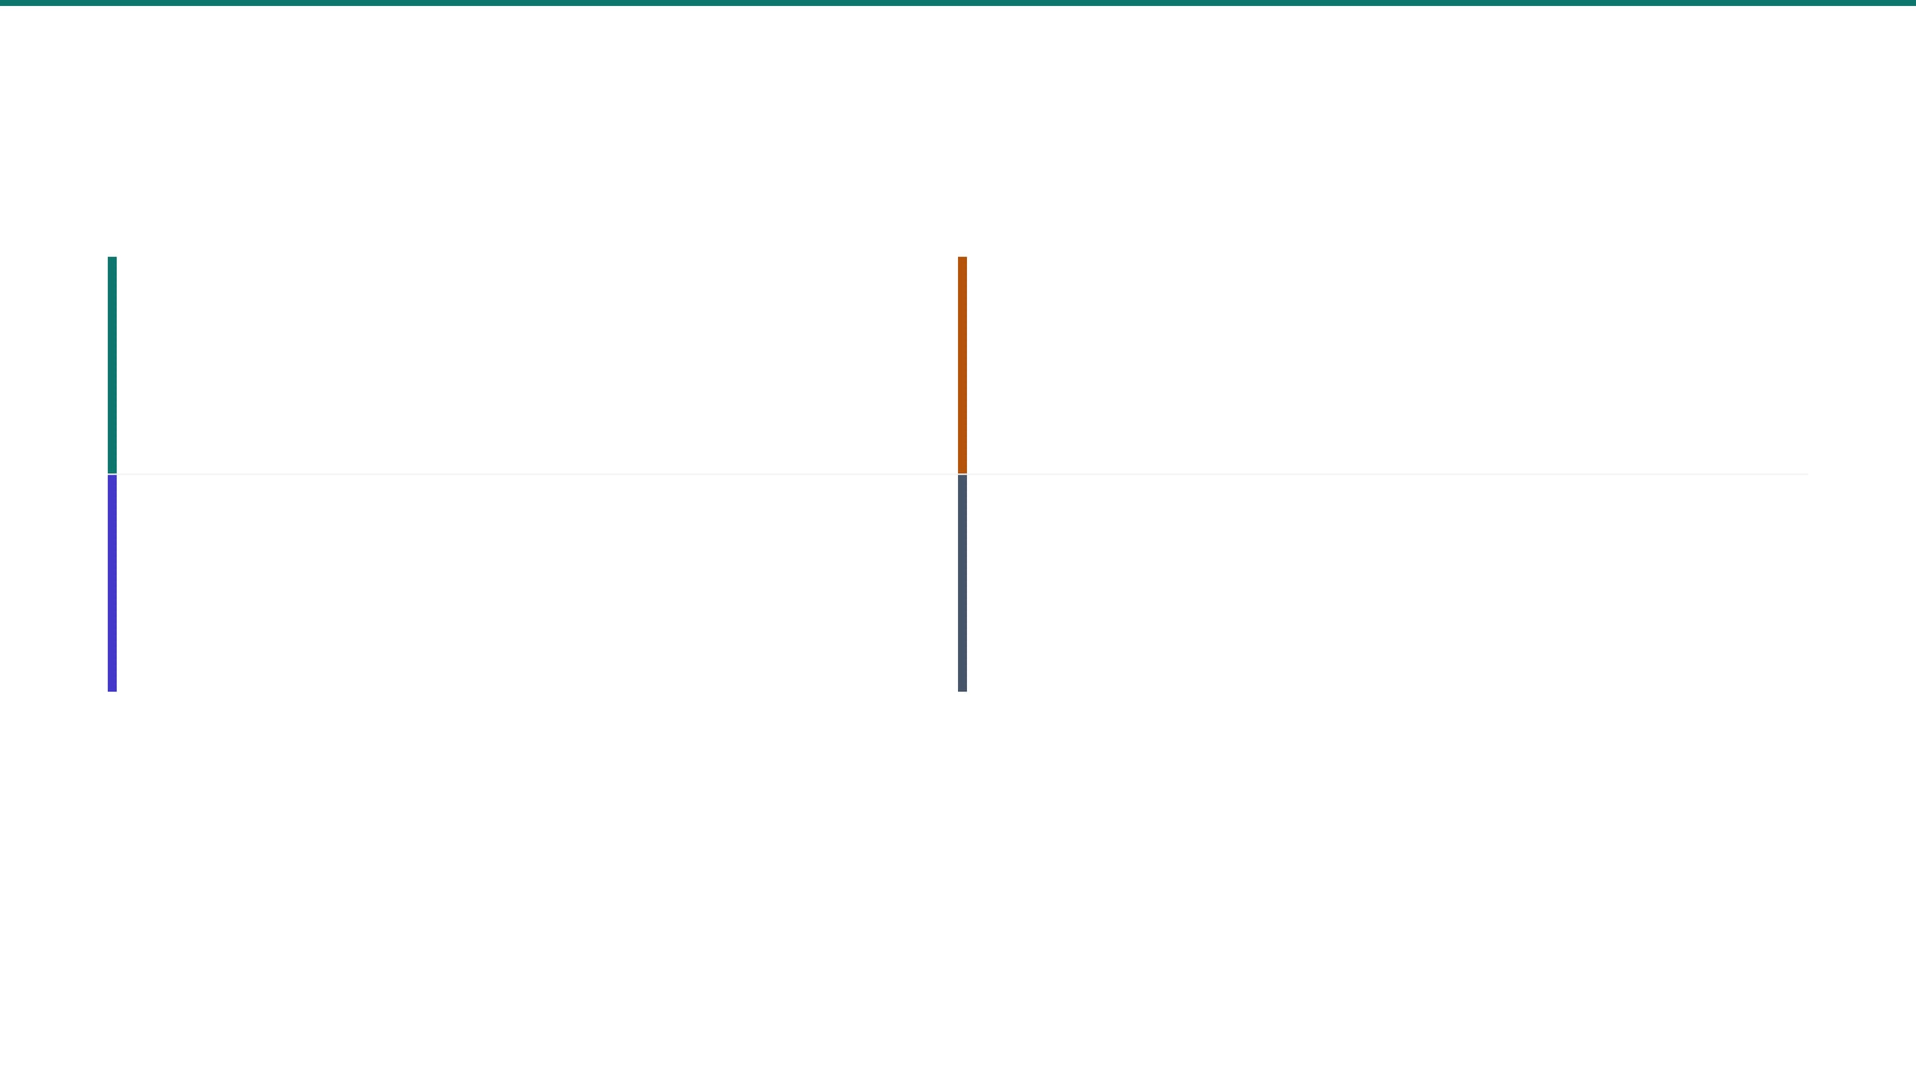
03 / MOLECULE KEY
Four molecule categories define the colour system throughout this reference
Colour coding reflects which molecule has the prevailing clinical evidence, not clinical superiority
11
CBD Cannabidiol
3
THC Tetrahydrocannabinol
11 OF 18 INDICATIONS
3 OF 18 INDICATIONS
Prevailing evidence across epilepsy, psychiatry, addiction, and emerging indications
Prevailing evidence in CINV, AIDS-related wasting, and Tourette's syndrome
3
CBD : THC Combination
1
Insufficient Evidence
3 OF 18 INDICATIONS
1 OF 18 INDICATIONS
Prevailing evidence in MS spasticity, cancer pain, and neuropathic pain
Evidence base too weak to assign a prevailing molecule (TBI sequelae, preclinical only)
The prevailing molecule is an evidence-strength judgement, not a treatment recommendation. Full clinical decision-making must consider patient-specific factors, contraindications, and licensing status.
Cannabinoid Therapeutics Clinical Evidence Reference | Non-promotional
4 / 15

Slide 5

04 / LEVEL 1 INDICATIONS
CBD has the strongest evidence of any cannabinoid in drug-resistant epilepsy
Epidyolex
Cannabidiol oral solution, UK licensed
INDICATION 1
INDICATION 2
INDICATION 3
Dravet Syndrome
Lennox-Gastaut Syndrome
Tuberous Sclerosis Complex
1
LICENSED / STRONGEST
1
LICENSED / STRONGEST
1
LICENSED / STRONGEST
Pivotal Phase 3 RCT demonstrated significant reduction in convulsive seizure frequency at 10 to 25 mg/kg/day as adjunctive therapy.
Two Phase 3 RCTs showed significant reduction in drop seizures. Approved as adjunctive treatment for seizures associated with LGS.
Phase 3 RCT demonstrated significant seizure reduction. Extended the licensed indication for Epidyolex to TSC-associated seizures.
Refs: Devinsky 2017 [1], Devinsky 2018 [2]
Refs: Devinsky 2018 [2], Thiele 2018 [3]
Refs: Thiele 2021 [4]
⚠
THC contraindicated: Pro-convulsant risk and absence of paediatric safety data. No role in epilepsy management.
⚠
Hepatic monitoring required: Baseline and periodic LFTs per Epidyolex labelling, particularly with concomitant valproate.
Cannabinoid Therapeutics Clinical Evidence Reference | Non-promotional
5 / 15

Slide 6

05 / LEVEL 1 INDICATIONS
Sativex and Nabilone hold Level 1 evidence in their respective indications
The only indications where THC or THC:CBD products reach the highest evidence tier
MS-Related Spasticity
Chemotherapy-Induced N&V
Sativex (nabiximols)
Nabilone (Cesamet)
THC:CBD 1:1 oromucosal spray | UK licensed
Synthetic THC analogue | UK licensed
LEVEL 1 — LICENSED / STRONGEST
LEVEL 1 — LICENSED / STRONGEST
KEY EVIDENCE
KEY EVIDENCE
Two pivotal Phase 3 RCTs and an enriched-design responder trial demonstrate efficacy for MS-related spasticity inadequately responsive to other antispastics. CBD monotherapy has no robust evidence in this indication.
Nabilone and dronabinol are both supported by Phase 3 RCTs and meta-analyses. Nabilone is licensed in the UK as Cesamet for CINV. CBD has no licensed CINV indication and limited data in this area.
Refs: Collin 2007 [20], Novotna 2011 [21]
Refs: Tramer 2001 [17], Whiting 2015 [18]
CBD monotherapy has no robust evidence in either of these indications. THC or THC:CBD products are the prevailing molecules.
Cannabinoid Therapeutics Clinical Evidence Reference | Non-promotional
6 / 15

Slide 7
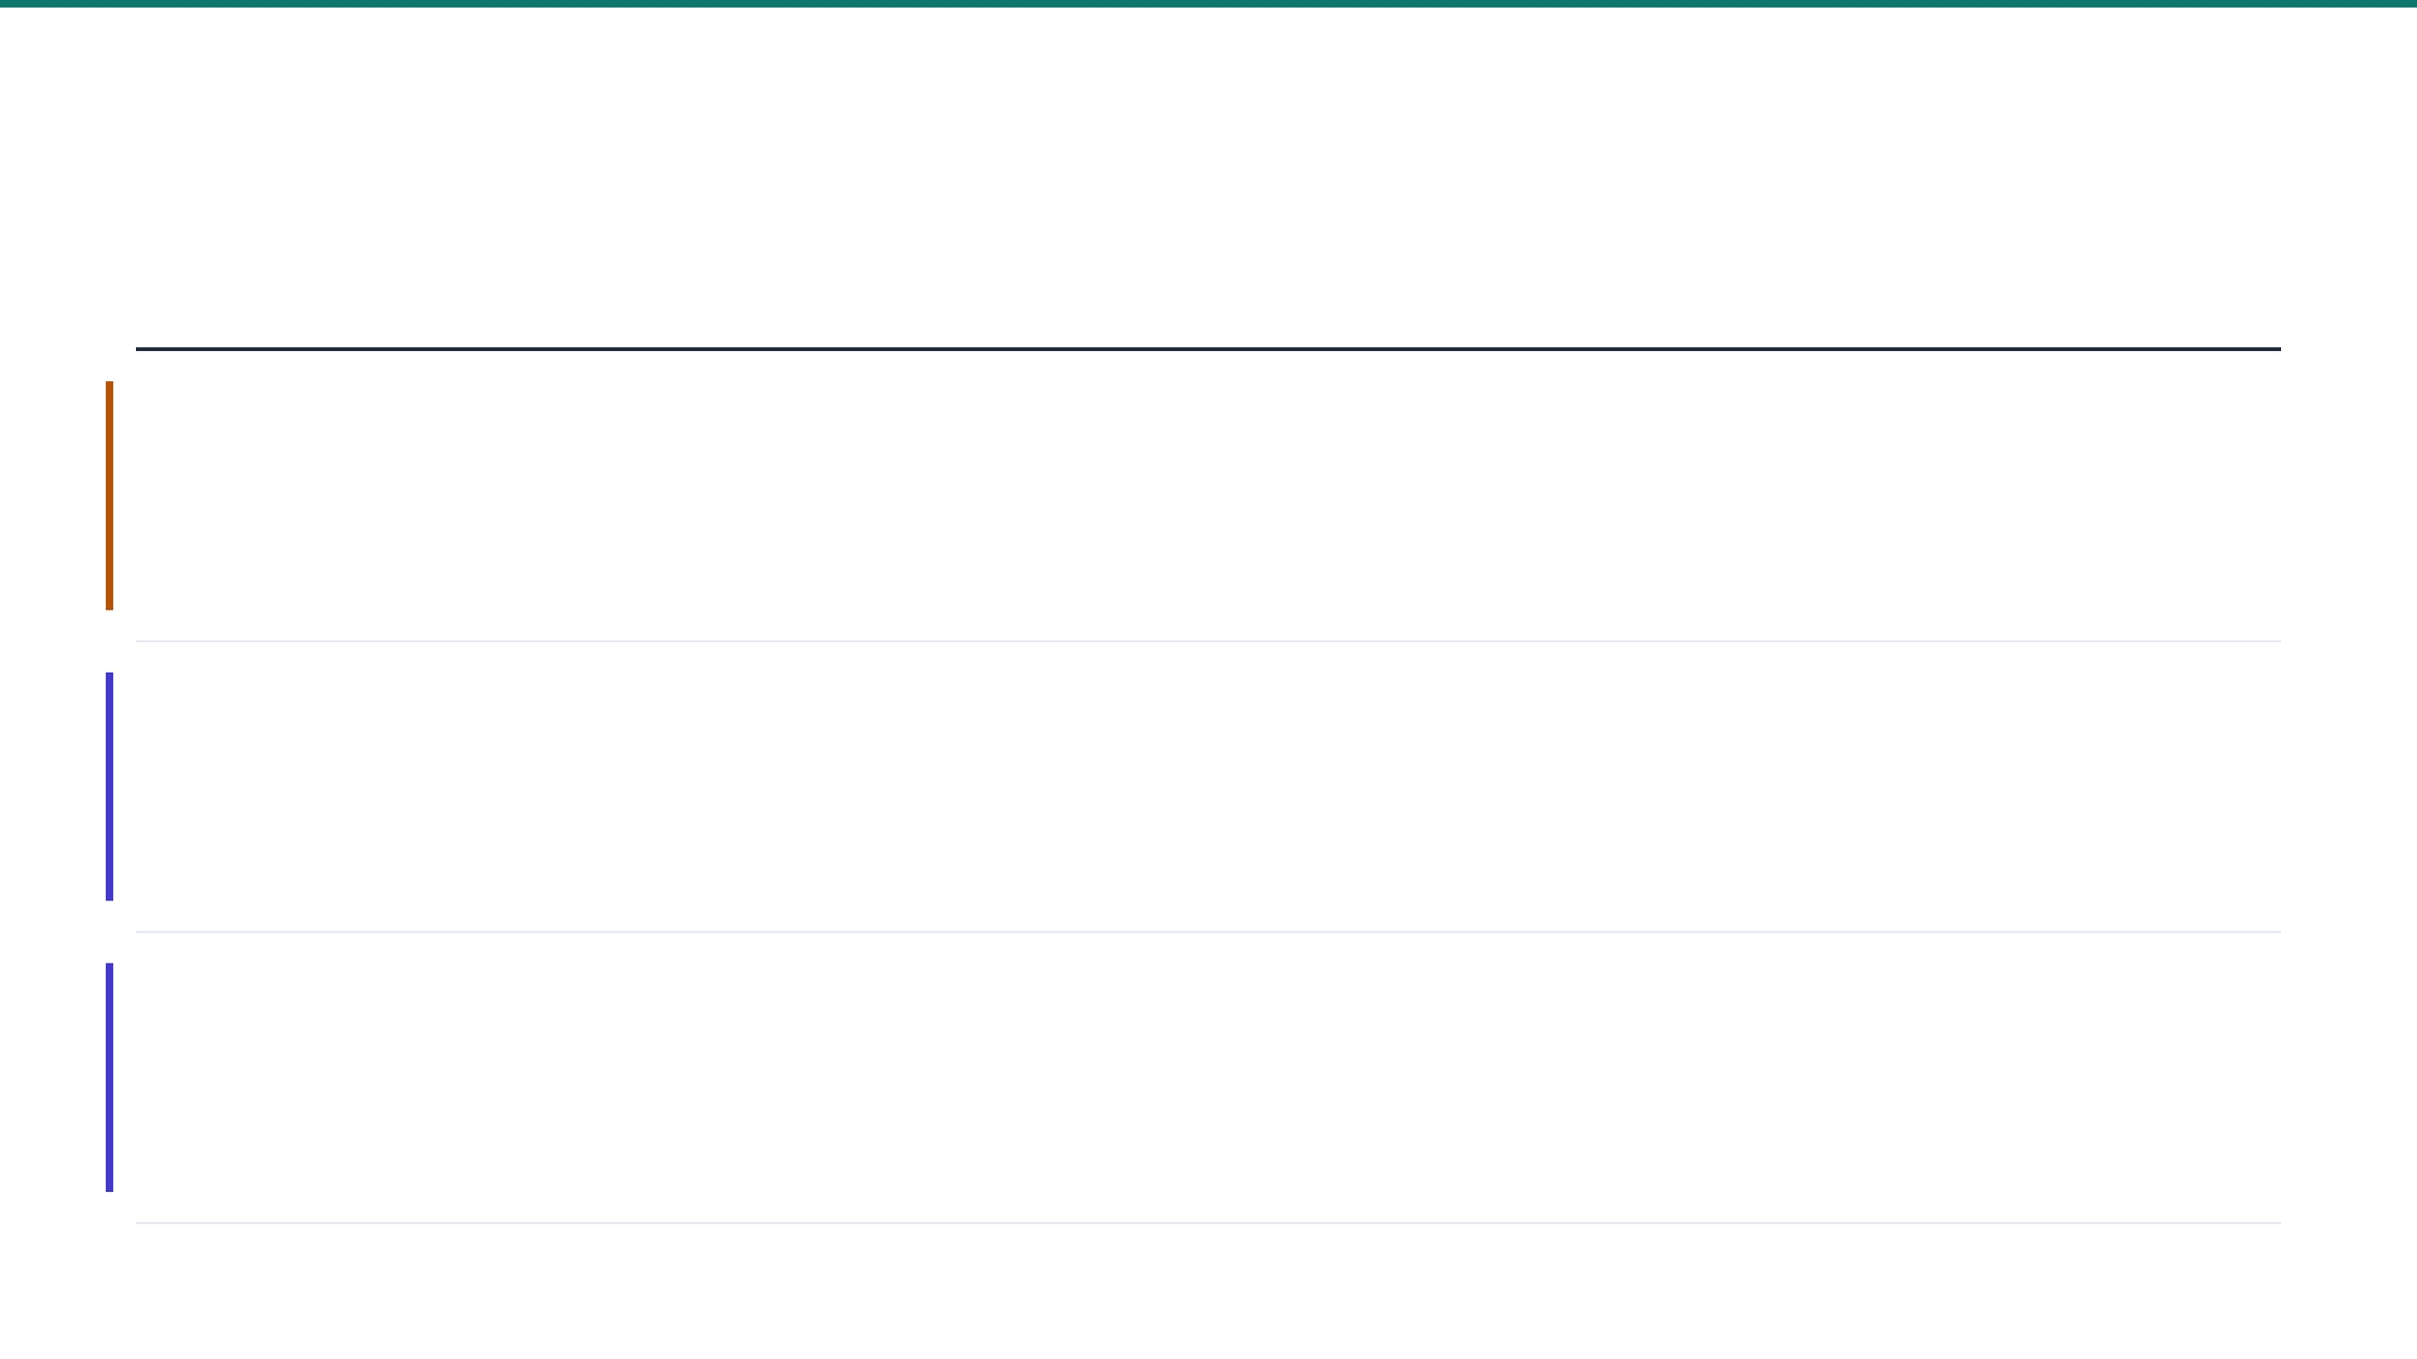
06 / PAIN & ONCOLOGY
Cancer pain and neuropathic pain show evidence signals but mixed Phase 3 results
AIDS-related wasting retains the strongest THC evidence outside licensed indications
INDICATION & LEVEL
MOLECULE & EVIDENCE
UK STATUS & VERDICT
AIDS-Related Wasting
THC
Specials / unlicensed only
2
STRONG RCT
Dronabinol (synthetic THC) supported by Beal 1995/1997 trials demonstrating appetite stimulation and weight stabilisation. FDA-approved as Marinol. CBD has no clinical evidence for appetite stimulation.
Not UK-licensed. Available via Specials import on consultant authorisation. THC analogue has strongest evidence.
Refs: 16, 17, 18
Cancer Pain
CBD : THC
Sativex (off-label)
3
MODERATE
Earlier Phase 2/3 trials positive (Johnson 2010, Portenoy 2012) but subsequent Phase 3 failed primary endpoints (Lichtman 2018). CBD monotherapy not supported in cancer pain.
Licensed product used off-label. Evidence signal exists; mixed Phase 3 results. Specialist justification required.
Refs: 18, 22, 23, 24
Chronic Neuropathic Pain
CBD : THC
Sativex (off-label)
3
MODERATE
Whiting 2015 meta-analysis shows modest effects for CBD:THC on central neuropathic pain. CBD monotherapy data weak. THC monotherapy poorly tolerated at therapeutic doses.
UK guidance does not support routine cannabinoid prescribing for chronic pain.
NICE CAUTION
Refs: 18, 22, 23, 24
Cannabinoid Therapeutics Clinical Evidence Reference | Non-promotional
7 / 15

Slide 8

07 / PSYCHIATRY
⚠ PSYCH CAUTION
CBD shows positive psychiatric signals; THC is contraindicated in all psychiatric indications
INDICATION
LEVEL
KEY EVIDENCE
VERDICT
Schizophrenia (Adjunct)
3
Leweke 2012: CBD vs amisulpride, comparable efficacy. McGuire 2018: CBD adjunct 600-800 mg/day, positive primary endpoint. Boggs 2018: negative at lower dose.
CBD has only positive evidence; THC contraindicated
CBD monotherapy or adjunct
MODERATE
Refs 5, 6, 7, 8
Social Anxiety / Acute Performance Anxiety
3
Bergamaschi 2011, Crippa 2011, Linares 2019: acute-dosing RCTs at 300-600 mg showing reductions in anticipatory and performance anxiety. No chronic Phase 3 data.
CBD has small acute-dose RCT support; not licensed
Acute single-dose studies
MODERATE
Refs 9, 10, 11
Generalised Anxiety Disorder
4
No chronic-dosing Phase 3 data. Evidence extrapolated from acute social anxiety studies. Chronic GAD efficacy not established.
CBD has emerging signal; chronic efficacy not established
Chronic dosing extrapolation
EMERGING
Refs 9, 10, 11
⚠
THC contraindicated across all psychiatric indications. Anxiogenic at higher doses, associated with psychosis onset. Personal or family history of psychotic disorders, active substance use disorder are absolute contraindications.
Cannabinoid Therapeutics Clinical Evidence Reference | Non-promotional
8 / 15

Slide 9

08 / EMERGING SIGNALS
Emerging CBD signals in PTSD and addiction; THC for Tourette's under specialist supervision
4
EMERGING
3
MODERATE
3
MODERATE
CBD
CBD
THC
⚠ PSYCH CAUTION
⚠ PSYCH CAUTION
Tourette's Syndrome
PTSD
Opioid / Cannabis Use Disorder
Muller-Vahl small Phase 2 work supports nabilone (THC analogue) for tic reduction. CBD has minimal data in this indication. Off-label use of nabilone under specialist supervision only.
Elms 2019 case series (11 patients, oral CBD adjunctive) showed reduced PTSD symptom severity. Bonn-Miller 2021 open-label data provide additional support. Smoked cannabis observational work is methodologically weaker and confounded by THC.
Hurd 2019 Phase 2 RCT: CBD reduced cue-induced craving and anxiety in heroin use disorder. Freeman 2020 Phase 2: CBD for cannabis use disorder showed positive Bayesian signal. THC is contraindicated in addiction medicine.
THC analogue has limited supportive data
Refs: 19
CBD has emerging signal; investigational only
CBD has emerging Phase 2 support; THC contraindicated
Refs: 12, 25
Refs: 13, 14
PTSD and substance use disorder rows carry PSYCH CAUTION tags. THC is contraindicated in addiction medicine and carries psychosis-onset risk in PTSD populations.
Cannabinoid Therapeutics Clinical Evidence Reference | Non-promotional
9 / 15

Slide 10

09 / EMERGING & PRECLINICAL
Parkinson's, autism, insomnia, and TBI represent early-stage CBD signals
All four indications are CBD-dominant; THC has no evidence base in any of these areas
4
Parkinson's Disease
4
Autism (Irritability, Behaviour)
EMERGING
EMERGING
CBD (weak signal)
CBD-rich (20:1)
Small RCTs (Chagas 2014; Peball 2020 in REM sleep behaviour disorder) suggest CBD may help non-motor symptoms. Motor evidence is weaker.
Aran 2019 RCT of CBD-rich extract (CBD:THC 20:1) in children with severe autism showed modest improvements in disruptive behaviour and anxiety.
Refs: 15
Refs: 15
4
Insomnia Disorder
5
Traumatic Brain Injury / TBI Sequelae
EMERGING
PRECLINICAL
CBD (emerging)
CBD (investigational)
Narayan 2024 pilot RCT (150 mg nightly CBD) provides initial controlled data. THC reduces sleep latency acutely but disrupts architecture and shows tolerance. CBD preferred.
Aychman 2023 review supports CBD neuroprotective rationale based on anti-inflammatory and antioxidant mechanisms. No human efficacy data established.
Refs: 27
Refs: 26
All four indications are CBD-dominant. THC has no evidence base and is generally unsuitable due to psychiatric risk profiles in these patient populations. Specialist supervision essential for any Specials prescribing.
Cannabinoid Therapeutics Clinical Evidence Reference | Non-promotional
10 / 15

Slide 11

10 / REGULATORY
UK cannabinoid prescribing spans three distinct regulatory categories
Prescribers must explicitly identify the applicable pathway before prescribing
PATHWAY A
PATHWAY B
PATHWAY C
Licensed Medicines
CBPM (Schedule 2)
Pure CBD Specials
Epidyolex
Sativex
Cesamet
THC-containing unlicensed products
Pharmaceutical-grade CBD, negligible THC
Full UK marketing authorisation. Standard prescribing and dispensing pathways apply. These are the only three cannabinoid-based medicines with licensed indications in the UK.
Cannabis-based products for medicinal use under Misuse of Drugs Regulations 2018. Any product containing THC above trace levels that is unlicensed falls into this category.
Pure CBD-only medicinal products with negligible THC may fall outside the CBPM controlled-drug framework. However, if supplied for a therapeutic indication, they remain medicines under the applicable MHRA licensed or unlicensed/Specials framework.
Prescribing: Restricted to specialists on the GMC Specialist Register. Prescribers should document treatment details, clinical outcomes, and adverse events, and use local or national registers where available.
Prescribing: Any registered medical practitioner may prescribe within the licensed indication. Off-label use requires specialist justification.
Prescribing: Not subject to Schedule 2 obligations or Specialist Register restriction. Formal legal/regulatory confirmation should be obtained before external use.
The regulatory classification of a specific product depends on its composition, THC content, and intended use. This summary is for general orientation only and does not constitute legal advice.
Cannabinoid Therapeutics Clinical Evidence Reference | Non-promotional
11 / 15

Slide 12

11 / SPECIALS PRESCRIBING
Eight mandatory requirements for Specials prescribing in UK practice
All eight conditions must be satisfied before initiating an unlicensed cannabinoid product
01
02
Particular patient under specialist care
Special clinical need not met by a licensed medicine
Not for general population prescribing. Patient must be under the direct care of a specialist clinician.
Documented in the patient record with clinical rationale for why licensed alternatives are unsuitable.
03
04
Clinical responsibility accepted by prescribing physician
MHRA reporting and pharmacovigilance compliance
Specials dispensed against the named clinician's judgement. Responsibility cannot be delegated.
Adverse events reported via Yellow Card. Ongoing safety monitoring throughout treatment.
05
06
Batch traceability maintained
Informed consent documented
Importer/manufacturer documentation retained per dispensing event for full supply chain audit.
Patient understands the unlicensed status and consents to the specific product being prescribed.
07
08
CBD-class hepatic monitoring
Drug-interaction screening
Baseline and periodic LFTs per Epidyolex labelling, particularly with concomitant valproate.
CBD-CYP3A4 and CYP2C19 interactions; THC-warfarin; common psychotropics. Screen before initiation.
Cannabinoid Therapeutics Clinical Evidence Reference | Non-promotional
12 / 15

Slide 13
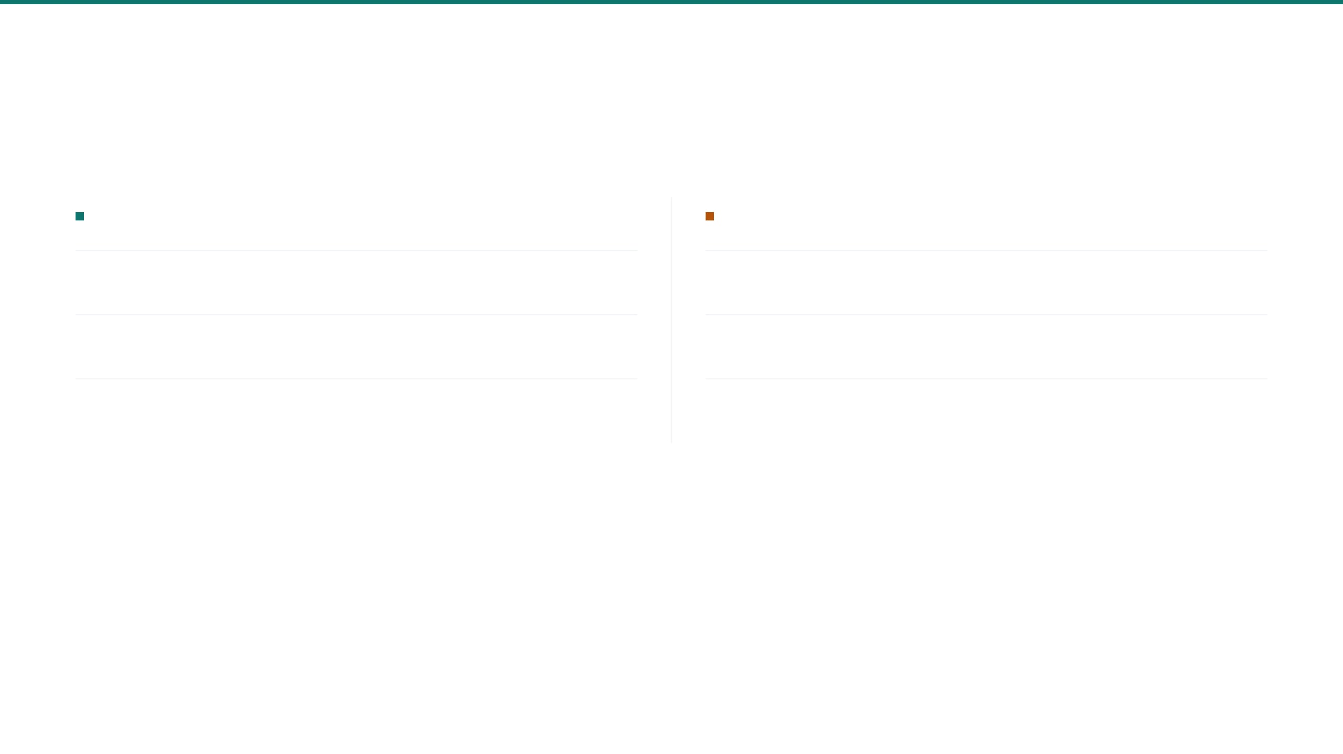
12 / DRUG INTERACTIONS
CBD and THC have clinically significant CYP450 and pharmacodynamic interactions
Screen all concomitant medications before prescribing. Full quick-reference card provided separately.
PHARMACOKINETIC (CYP450 MEDIATED)
CBD
THC
CYP3A4 & CYP2C19 inhibitor
CYP3A4 substrate
CYP3A4 inhibition
Clobazam ↑, midazolam ↑, tacrolimus ↑, everolimus ↑ — monitor levels and reduce doses
Levels increased by
Ketoconazole, ritonavir, clarithromycin ↑ — CYP3A4 inhibitors raise THC exposure; increased CNS effects
CYP2C19 inhibition
Clobazam (N-desmethyl) ↑, SSRIs ↑, warfarin ↑, phenytoin ↑ — INR and TDM monitoring
Levels decreased by
Rifampicin, carbamazepine, phenytoin ↓ — CYP3A4 inducers reduce THC efficacy
UGT pathway
Valproate — combined hepatotoxicity risk; baseline and periodic LFTs mandatory
Warfarin
THC + warfarin ↑ INR — enhanced anticoagulant effect; close INR monitoring required
PHARMACODYNAMIC INTERACTIONS
CBD + Valproate
THC + CNS Depressants
THC + Sympathomimetics
Additive hepatotoxicity. Transaminase elevations documented at high CBD doses. LFT monitoring mandatory per Epidyolex labelling.
Additive sedation with opioids, benzodiazepines, alcohol, gabapentinoids. Dose adjustment and patient counselling required.
Additive tachycardia and hypertension risk. Caution with stimulants and decongestants in cardiovascular-risk patients.
MODERATE SEVERITY
HIGH SEVERITY
HIGH SEVERITY
Cannabinoid Therapeutics Clinical Evidence Reference | Non-promotional
13 / 15

Slide 14

13 / CAVEATS
Caveats and Limitations
01
Working draft status
This document is a working draft. It has not been finalised, peer-reviewed, or approved for external distribution. Content may change without notice.
02
Evidence-strength mapping only
This reference defines explicit boundaries on its scope, accuracy, and intended use. All users must read and accept these limitations before relying on any content.
Maps relative evidence strength across indications. Does not constitute prescribing recommendations, clinical guidelines, or treatment protocols.
03
Independent verification required
All references, regulatory positions, and clinical claims require independent verification before any external clinical, regulatory, or promotional use.
DOCUMENT STATUS
04
Non-promotional and product-neutral
WORKING DRAFT V1.0
This document does not promote any specific product, company, or commercial interest. No endorsement is implied by the inclusion of any product name.
CLASSIFICATION
NON-PROMOTIONAL
05
Not a substitute for clinical judgement
Patient-specific treatment decisions remain the responsibility of the prescribing clinician. This reference does not replace local governance or formulary processes.
06
Regulatory positions may change
UK regulatory and NICE guidance positions are subject to change. Always check the current MHRA, NICE, and BNF sources before prescribing.
07
Specials framework classification
Pure CBD products with negligible THC may fall outside CBPM controlled-drug obligations but remain medicines under the applicable MHRA licensed or unlicensed/Specials framework.
Cannabinoid Therapeutics Clinical Evidence Reference | Non-promotional
14 / 15

Slide 15

15 / SUMMARY
Cannabinoid Therapeutics: Clinical Evidence at a Glance
18
5
3
27
Indications Mapped
Evidence Levels
UK-Licensed Medicines
References Cited
Across epilepsy, neurology, psychiatry, pain, oncology, addiction, sleep, and emerging areas
From Level 1 Licensed/Strongest through to Level 5 Preclinical
Epidyolex, Sativex, and Cesamet hold marketing authorisations
Peer-reviewed trials, meta-analyses, and regulatory sources
RECOMMENDED NEXT STEPS
01
02
03
Verify independently
Consult product-specific guidance
Report adverse events
All references, regulatory positions, and evidence grades require independent verification before external clinical, regulatory, or promotional use.
Review SmPCs, NICE guidance, and local governance frameworks before initiating any cannabinoid prescribing. Patient-specific factors must guide decisions.
All suspected adverse reactions should be reported via the MHRA Yellow Card scheme. Ongoing pharmacovigilance is essential for all cannabinoid products.
Working Draft v1.0 | Non-promotional clinical reference for UK prescribers. Does not constitute medical advice. This document does not replace patient-specific clinical judgement, product-specific regulatory review, or local governance.
Cannabinoid Therapeutics Clinical Evidence Reference | Non-promotional
15 / 15

